Slide 1
GBU-54 and 2407 GSMS Academics for 2407 CAO 30 Oct 2018
POC: Mr Alex “Draco” Kreston
Capt Mark “RACC” Kuhn

Slide 2
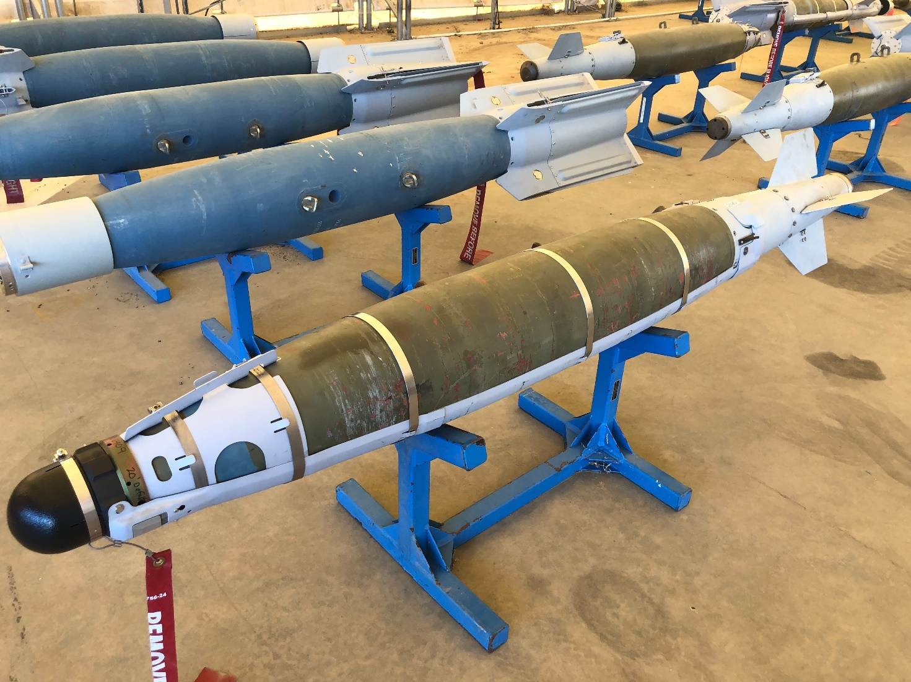
Overview
Quicklook
Specs
LR Preflight
Guidance
CDO
Laser Summary
SMS Changes
HUD
LAR
Tactics

Slide 3
GBU-54

Slide 4
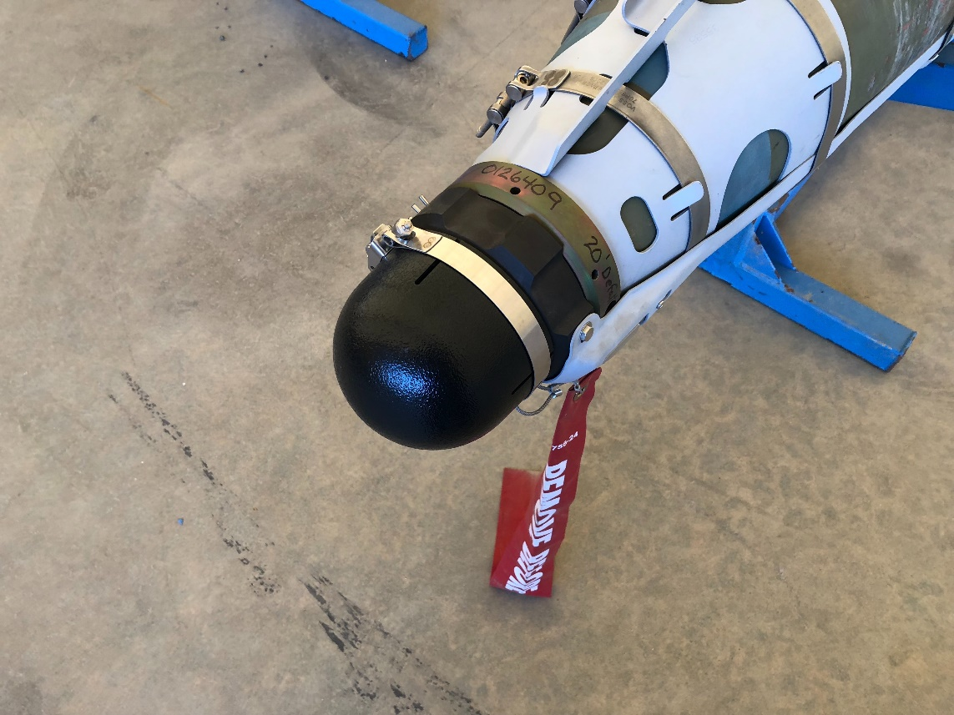
Quick Look
GBU-54 is a dual mode GPS/Laser guided weapon
GBU-38 with Laser capability
Can hit moving targets up to 70mph (according to Boeing)
Lose LAR at 75mph
HOB and delayed fuze functions
Fully functioning SMS (no backdoor needs) with no need for GBIT
Must remove black plastic cover to see PRF code, put it back on after

Slide 5
GBU-38+DSU-38 Laser Kit Assembly=GBU-54
GBU-38 with DSU-33 (for HOB)
Laser Kit Assembly with DSU-38

Slide 6
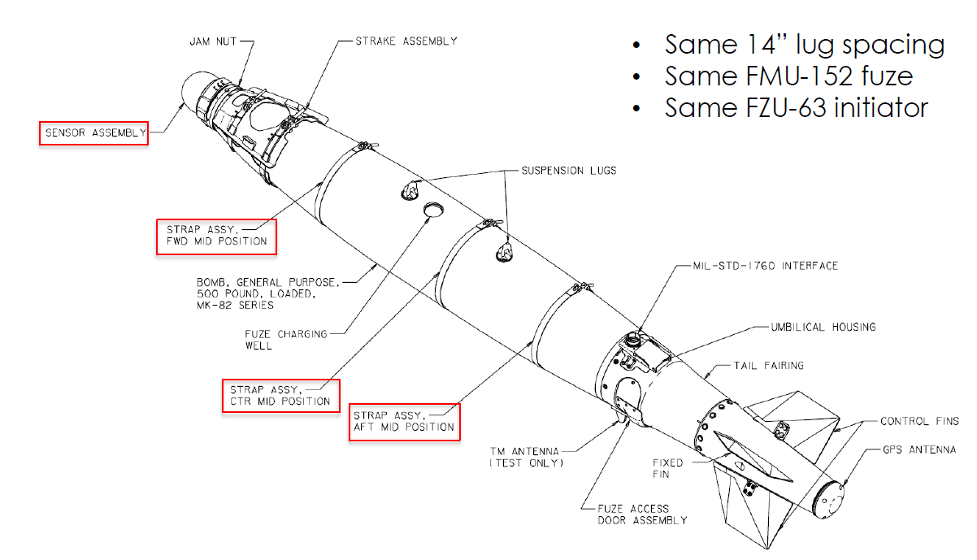
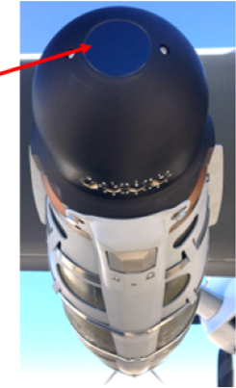
GBU-54 Detailed
Laser Sensor
Adjustable Proximity Sensor (APS)
Optical Input Window

Slide 7
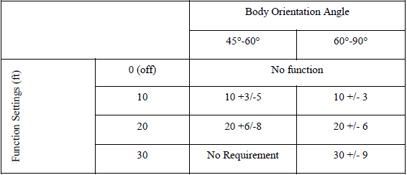
Adjustable Proximity Sensor (APS)
Note that the table specifies body orientation angle, not impact angle. Body orientation angle and impact angle differ by the angle of attack (AOA) and body roll orientation at impact. A high AOA and 0° roll orientation at impact may decrease the body orientation angle up to approximately 20°. A high AOA and 180° roll orientation may increase the body orientation angle up to approximately 20°.

Slide 8
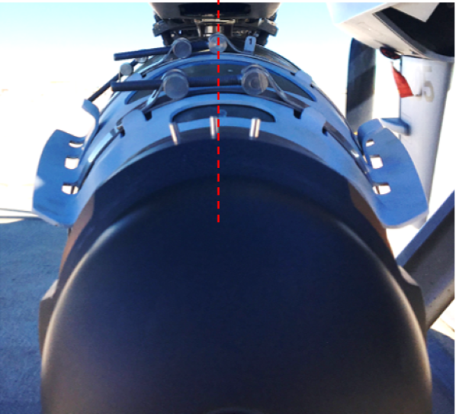
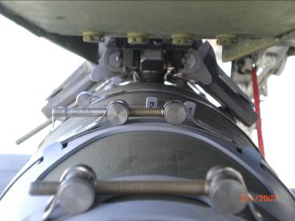
GBU-54 Pre-Flight (LR only)
Verify that the laser codes switches are set to the desired setting (if the first switch setting is undefined, “1L” should be used as the default)
Ensure that the sensor protective cover on the Laser kit has been removed before flight and that the lens is clean and undamaged with no cracks or significant pitting
If the suspension lugs are visible, verify that the middle sensor alignment feature on the sensor is aligned within the interior width of the suspension lugs, 2-tab should be aligned within lug as well.
Check integrity of the laser cable cover and retention straps and ensure that all hardware is secure
DSU-38 Sensor Alignment
2-Tab

Slide 9
Last Pulse Logic/Keystone Keys
Two last pulse logic settings on GBU-54
–Long Last Pulse Logic
Less susceptible to obscurants (smoke, fog, haze) between laser designator and target
–Short Last Pulse Logic
Rejects small signal returns from longer ranges
Reduces the probability of tracking illuminated items behind desired target (trees or other objects) in the case of energy spill over target
If in doubt, select “LONG”
The rest of pre-flight is the exact same as for a GBU-38
Make sure Mx is loading 1st and 2nd YELLOW keys from SKL in order to get proper cover days. May have to search folders, not always first.
If your cover days are showing 0 then you are not going to drop with GPS guidance, it will be INS only even if you have Keystone Keys loaded. Without cover days the JDAM can’t read the crypto for the Sat.

Slide 10
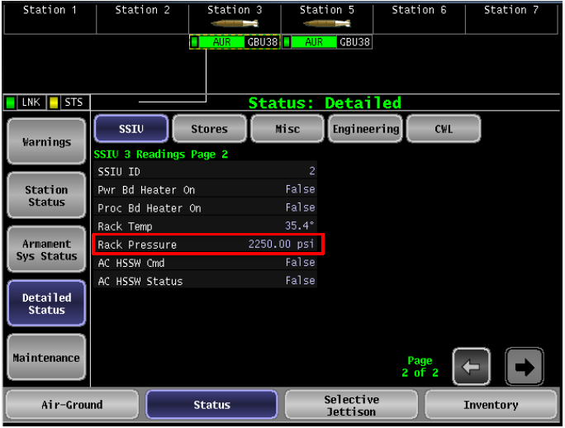
BRU-71/A Pressure Readings
2407 software now has rack pressure under “Detailed Status”, “SSIU”, Page 2

Slide 11
Moving Target Logic
Boeing Proprietary
Weapon targeted with a speed bias & heading from MTS
Calculates velocity bias and TOF for Predict Ahead Point (PAP) which is where the target “should be” at impact
Calculates “Phantom Aimpoint” 4.5 km up from PAP to ensure target will be within FOV at acquisition (4.5km or about 15 sec TTI) (Similar to THB for HF)
Weapon guides using only GPS/INS to Phantom Aimpoint (laser seeker active but will not maneuver to it)
Laser spot acquired at 4.5km and proportional navigation (pro-nav) guidance begins at 4km (13Kft)
Weapon is guiding to updated GPS coordinates taken from angle measurements and target velocity vector to continually update original target coordinates
Predict Ahead Point
Offsets weapon FOV to Laser spot angles measured/compared to current Predict Ahead Point coordinates
Any difference in angle is treated as change in heading / velocity and Predict Ahead Point is re-calculated based on perceived velocity change and remaining TOF
Boeing Proprietary

Slide 12
Moving Target Logic Cont…
Lower PRF provide best update rates for calculations (recommend 1111)
If laser energy is never acquired the weapon will hit its Predict Ahead Point calculated at release (you don’t know where this is)
If laser energy is lost once acquired, the weapon will continue to its updated Predict Ahead Point based on the last velocity vector and coordinate from the laser.
So, if the veh continued on after laser loss without changing speed or course, the weapon would hit the target (theoretically)
Seeker Stats:
+/- 25˚ Field of Regard
+/- 15˚ Circular Field of View

Slide 13


Laser vs Fast Moving TGT
Boeing Proprietary
Weapon guides initially with INS as it acquires GPS and begins guiding to Phantom Aim Point coordinates to ensure vehicle remains in seeker FOV
Weapon targeted via Tgting Pod, including velocity and vector bias
“Phantom Aim Point” calculated by LJDAM
Weapon released
Weapon acquires laser spot, updates predicted impact point, begins guiding to continuously updated impact coordinates using proportional nav (pulls lead)
“Phantom Aim Point” (Based on Impact Angle)
Initial Predict Ahead Point
Weapon maneuvers to updated calculation of impact point
Position of Target at release (when weapon is targeted)
Seeker FOV
(if in fixed target mode)
Seeker FOV (based on pre-release predicted target position based on velocity bias and target vector at weapon release)
Seeker FOV
Boeing Proprietary
Notes:
When the bomb releases from the aircraft, it calculates the current time since release to generate coordinates during TOF

Slide 14
Impact Angle
Boeing Proprietary
Recommend setting 70 Deg Impact Angle for moving targets
IA only affects JDAM trajectory shaping to the Phantom Aimpoint
Once Laser acquired, it will no longer attempt to hit a selected IA
LAR not impacted much either way between 65 and 90
Laser acquisition area is greater with lower IA, the one negative is if the veh slows considerably or stops (then you are getting less area behind the veh that the laser is searching with lower IA set)…plan accordingly
90 IA
65 IA
*Not to Scale
Boeing Proprietary

Slide 15
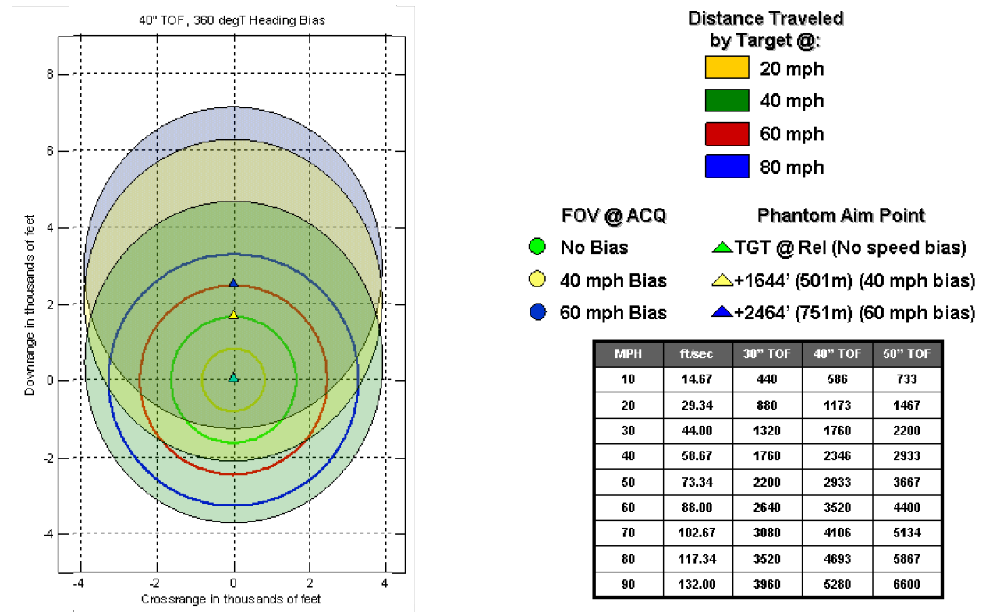
Target Handover Boundary
Boeing Proprietary
Ex: 60mph car starts at 0, travels to red circle after GBU release.
GBU-54 travels to blue triangle and has the blue filled in circle as it’s FOV, begins laser guidance
Typical Release Range
*Not to Scale
Boeing Proprietary

Slide 16
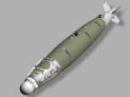
On Axis Drops
40” TOF
At 4.5 km FOV of the Seeker at the P.A. (70° impact angle 60mph mover) is -1250ft to 7000ft if the veh stopped immediately after release, but the vehicle should be at the 2600ft mark when the 54 reaches the P.A. so the FOV at the P.A. is -3850/+4400 based on release parameters of 60mph for the P.A.P. Cross range is +/-4000ft
~7 km
So if vehicle stops, it’s still within FOV by 1250ft but if it reverses course likely not
P.A. @ 60mph
-3850ft @ L.A.
+4400ft @ L.A.
Release Point
-1250ft
+2600ft
~2 nm GR (3.7 km)
+7000ft
3520ft @ 60mph Distance veh travels
L.A.= Laser Acquisition
P.A.= Phantom Aimpoint
P.A.P.= Predict Ahead Point
+/-4000ft XR
*NOT TO SCALE all #s interpolated from previous chart
VEH @ Release or if it stops immediately
P.A.P. @ 60mph

Slide 17
OWT
Boeing Proprietary
On Wing Track should always be set to ON (but not required outside CDO)
It acquires the Satellites first and then tracks them
As it tracks, it does not process the information
Once released it will process Sat data to guide to the Phantom Aimpoint
With OWT on it is possible for the JDAM to flash yellow occasionally as it loses one of the Sats, check the detailed status page to confirm. If loss of Sat, there is no degradation for normal release outside of a CDO environment as long as TXA1 present. You could also turn OWT off as long as you don’t expect CDO
OWT does not work with older ACP1/ACP2 Nighthawks need GPS SAASM Receivers
How you can tell during walk around:
If you have a FMU-572 A/B then no OWT
If you have a FMU-572 B/B or B/C then you have OWT
Boeing Proprietary

Slide 18
GBU-54 Limitations
Due to the Phantom Aimpoint, if a moving target reverses course or maneuvers aggressively immediately after release, there is a possibility that the bomb will never pick up the laser energy if you stay on the vehicle.
GBIT 1.3 SCR2056 has GBU-54s but not validated, use GWTS if preplanning static shots
There is no planning software at this point that can provide an accurate THB for moving tgts
Recommend doing route scans to inc confidence that the veh will not reverse or maneuver for at least 15 sec post release or wait for veh speed to slow below 30mph.
If you choose to attack a fast moving target you need to discuss whether you will stay on the veh or continue the track to pick up the bomb and then shift it.
If you stay with the track, continue the track speed and course until 15 TOF, then begin shifting to ensure you are in laser track mode
If you stay on the veh the bomb will most likely hit the Predict Ahead Point (which you don’t know)

Slide 19
GBU-54 Post Release Maneuvering
Consideration needs to be given for post release maneuvering on moving targets
Veh speed greatly affects what you should do post release
Less than 20mph*: Normal GBU turn at 69deg
Level straight thru in this regime can put the dep in the 80s and makes it more difficult for the SO due to the rotation of the MTS
Turning before 69deg throws the Nadir cone right over the veh
Altitude and release point play a factor in these decisions
Consider releasing later in the LAR to ensure earlier turn out
Greater than 20mph*: Level Straight-Thru
If released early in the LAR, dep should stay below 80deg
If dep is going to hit 80 with more than 10 TOF, execute Nadir Avoidance
Bottom Line: For slower moving targets there is high potential for Nadir situations to develop, plan accordingly
*Applies to greater than 20K HAT

Slide 20
INS Only LJDAM Performance (Boeing)
There is no effect on LJDAM accuracy performance when operating in a GPS-denied environment with OWT ON
Per the LJDAM specification, LJDAM will meet the accuracy requirements under the following conditions:
Target Location Error (TLE) less than or equal to 37m (1 sigma)
GPS quality handoff
GPS-Aided or Unaided (INS) LJDAM Navigation
Conditions to support a sufficient laser acquisition range
Uninterrupted laser designation of the target aim-point for the last 3km of flight (stationary targets) or the last 4km of flight (moving targets)
LJDAM operates in a relative navigation frame of reference during terminal guidance, thus INS drift is similar to TLE of JDAM
Since laser updates are taken from original coordinates, if jamming happens post release updates are made using INS

Slide 21
JDAM Unaided (INS Only) Accuracy >60° Impact, Horizontal Target
Miss Distance vs. Time-of-Flight
40
35
30
Requirement INS Only
CEP = 28.3 m at 100 sec
MQ-9 lives in this region
(138 s)
25
30,000 ft (16.9 m CEP)
CEP/Miss Distance (m)
20,000 ft (14.6 m CEP)
20
13 m CEP (30 s)
40,000 ft (21.2 m)
15
10
*Notice the CEP generally stays below 13m even with INS only at our TOFs
5
Requirement GPS Aided
0
0
10
20
30
40
50
60
70
80
90
100
Gray Line: Prediction of Performance With Specification Errors (INS only)
Time-of-Flight (sec)
Green Line (bottom curve):
Best Estimate of Current Performance With Actual IMU Errors (GPS)

Slide 22
Buddy Lase Considerations(Boeing)
LJDAM accuracy is a function of the laser spot being tracked during the terminal phase. In the event that multiple designators are lasing the target with the same PRF laser code and these multiple designations are within the field-of-view of the LJDAM sensor, the following should be considered.
• The initial designator that the LJDAM acquires and tracks is somewhat arbitrary, presuming more than one designation is visible in the field of view of the sensor. At initial acquisition, it requires 3 to 4 pulses to acquire and track.
• Once it has locked onto a particular designator, it is highly unlikely it will track other designators in the field-of-view, unless loss-of-lock occurs (for instance, if the pod quits lasing). It takes a loss of 4 pulses to declare loss-of-lock.
• Once loss-of-lock occurs, the LJDAM will attempt to reacquire a laser spot in the field-of view. As noted above, if there are still multiple designators in the field of view, it is somewhat arbitrary which signal the LJDAM will acquire and track.
In summary, for the multi-designator scenario described (same PRF laser codes within sensor field of view), it is highly likely that the LJDAM sensor will only track one designator and will not jump to an alternate designator unless loss of lock occurs on the original tracked designator.

Slide 23
Optimizing Laser Guidance Accuracy (Summary Chart) (Boeing)
Maintain Laser Spot on Target | Ensure spot is maintained on target (no leading or biasing of the aim-point). Weapon performance is relative to laser spot.
Continuous Lasing in Terminal Phase | Ensure continuous lasing 4km range-to-go before impact (~15 sec before impact) No penalty/degradation for early lasing Performance degrades with laser cut-off in terminal phase.
Laser Designation Relative to LJDAM Impact Angle | Laser designation Line of Sight (LOS) angle to target is within +/- 45° of weapon approach LOS (consistent with LGB conops). Maximizes probability of early laser acquisition.
Laser Designation Range | Within 5nm slant range during terminal phase (airborne designation) Within 1nm range during terminal phase (ground designation) Maximizes probability of early laser acquisition. Performance will degrade if acquisition is <4km for moving targets and <3km for fixed targets.
Laser Code | Available Range: 1111 to 1788 The update rate or laser pulse rate is fastest for the lower number codes (1111 20 Hertz) and slowest for the higher number codes (1788 < 10 Hertz). Select last pulse logic for conditions (1S or 1L on Laser Panel)
LJDAM Relative Targeting Mode | For onboard targeting systems, use relative targeting mode if available.

Slide 24
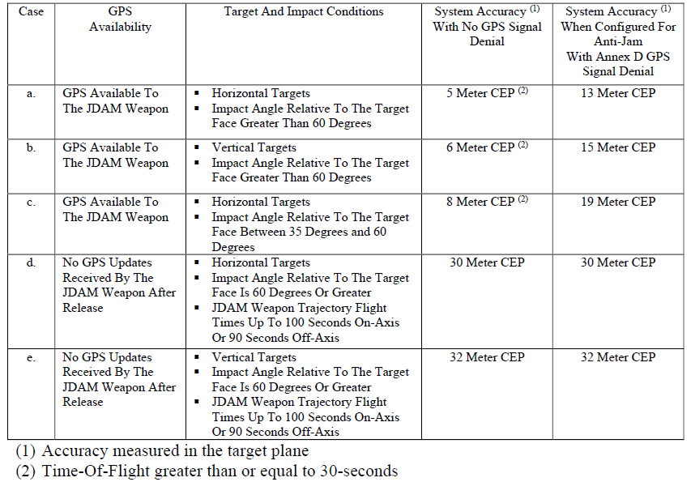
JDAM System Spec Accuracy cont. (Boeing)

Slide 25
SMS

Slide 26
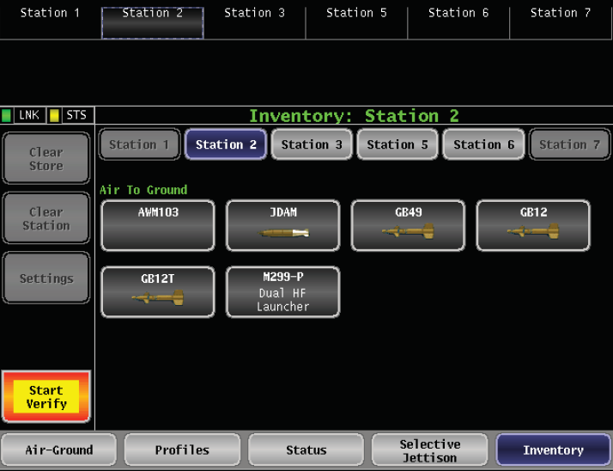
JDAM Inventory Page
Notes:
Similar HMI compared to GBU-38 in 2404

Slide 27
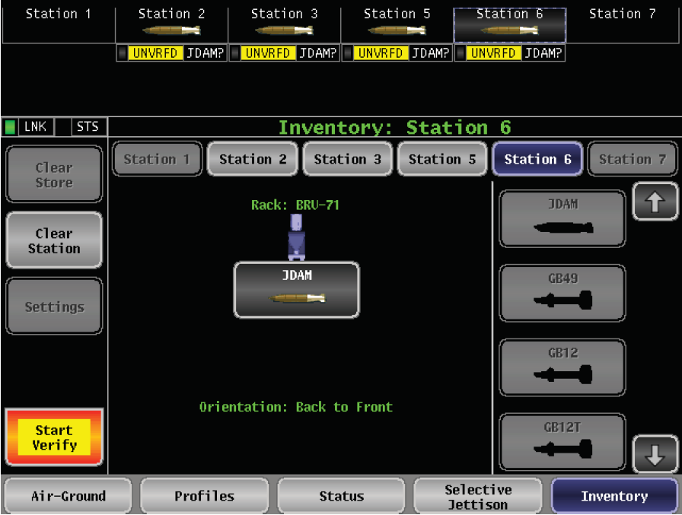
JDAM Inventory Page

Slide 28
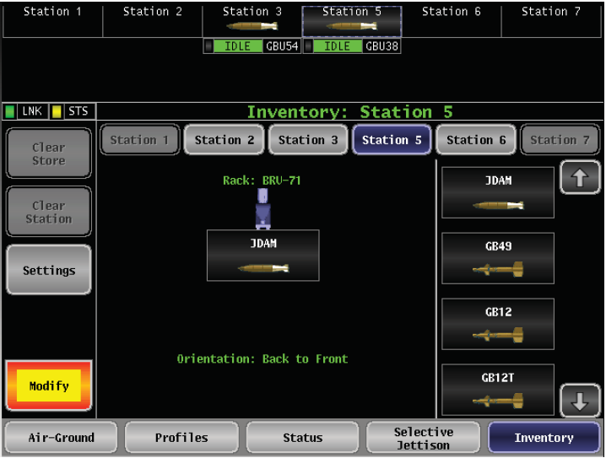
JDAM Inventory Page
SMS correctly identifies which type of JDAM it has
If you re-inventory with JDAM make sure you turn AUTO CCTGP OFF or you will get a SCC Software Fault that can only be reset with an MCM Hard Reset (turns MTS off w/B5 aircraft). However SCC Fault does not impact releases.

Slide 29
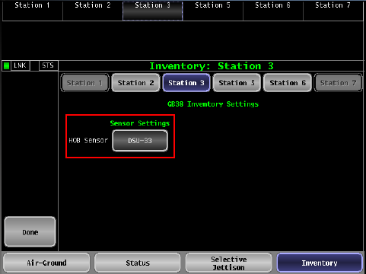
JDAM Inventory - HOB Settings
HOB sensor must be selected during GBU-54 inventory (if available) in order to activate the APS via the Airburst On/Off GSMS Store Settings page
Selecting HOB Sensor only unlocks GUI, has no affect on weapon
Similar to GBU-38, select DSU-33, then must hit ‘Done’ to inventory
Notes:
DSU-33 must be selected during GBU-54 inventory in order to activate the APS via the Airburst On/Off GSMS Store Settings page

Slide 30
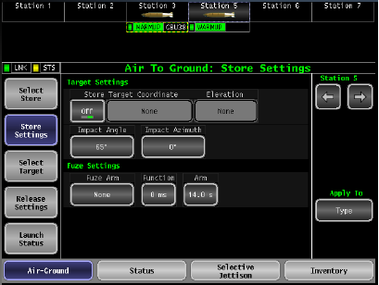
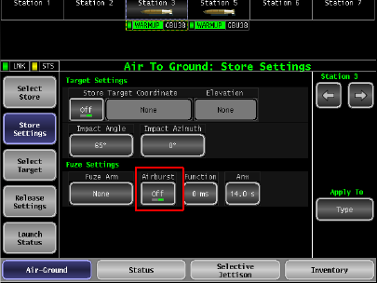
Store Settings – Airburst GBU-38
If HOB not Selected, Airburst Button hidden
Notes:
DSU-33 not Selected, Airburst Button hidden

Slide 31
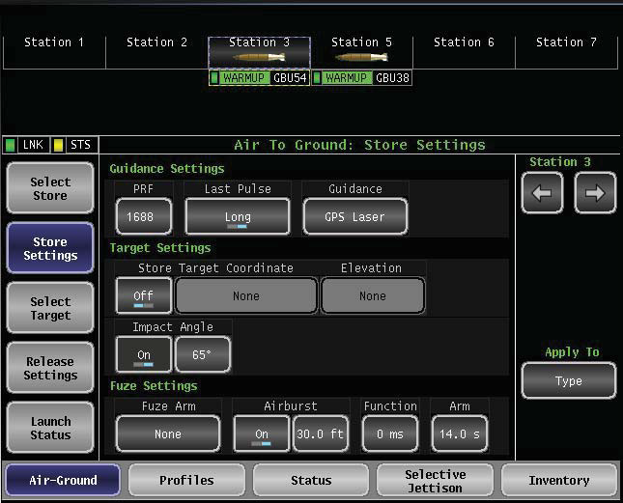
GBU-54 Store Settings
PRF 1111-1788
Guidance toggles between “GPS Laser” and “GPS”
Store Target Coordinate “off” if dropping on mover
Impact angle forced on in LAR mode (65-90deg for mover) (30-90 for stationary) (15-90 manual)
Best to leave Impact Azimuth off
Select all fuzes
Set Arm delay per 3-3
Airburst can be set to on or off
If “on” 20ft is the default, can select 10 or 30 as well.

Slide 32
JDAM Release Settings
TTR Type (STD rate turn assumed)
DPI – TTR displays total time req’d to turn to a course to intercept DPI
Tangent – total time to turn to a course to intercept nearest tangent point on circle about a DPI
Target Type disabled if in “Manual” mode
If Auto CCTGP is not selected, SMS will force target type to Stationary
On Wing Tracking (OWT)
Always set ON, unless malfunction, regardless if you have proper GPS receiver.

Slide 33
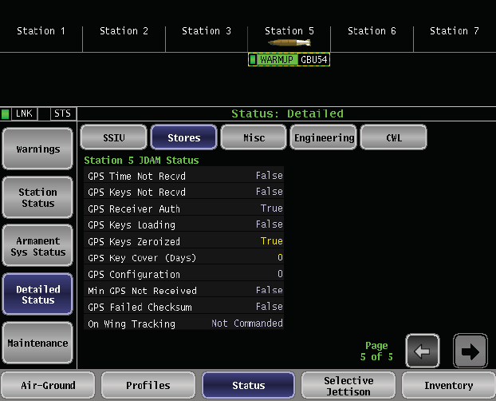
Detailed Status Page
On Wing Tracking (OWT)
4 Possible Status’
Not Commanded
Acquiring
Marginal
Good
Not Commanded = not ON or not compatible with GPS receiver

Slide 34
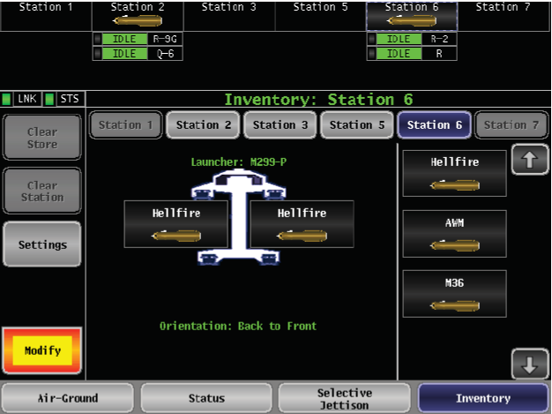
HF Inventory Page
SMS correctly identifies which type of HF it has

Slide 35
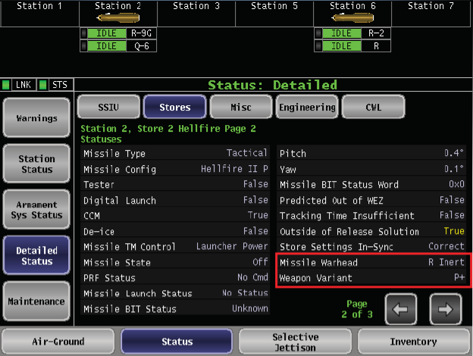
HF Detailed Status
The Detailed Status displays Missile Warhead and Weapon Variant

Slide 36
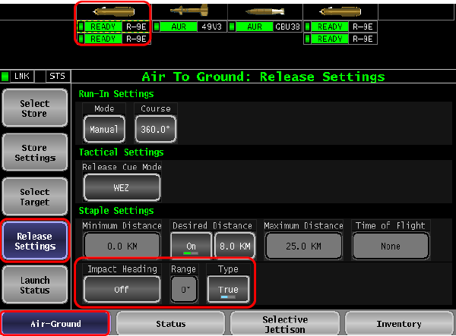
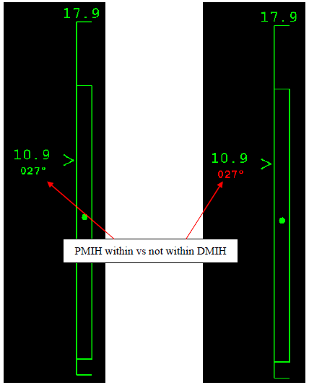
HF Release Settings Page
Desired Missile Impact Heading
0 deg = disabled
1-360 deg = Valid
360 deg = 0 deg
Desired Impact Heading Range (Treat like +/- DMIH)
0 – 180 deg range

Slide 37
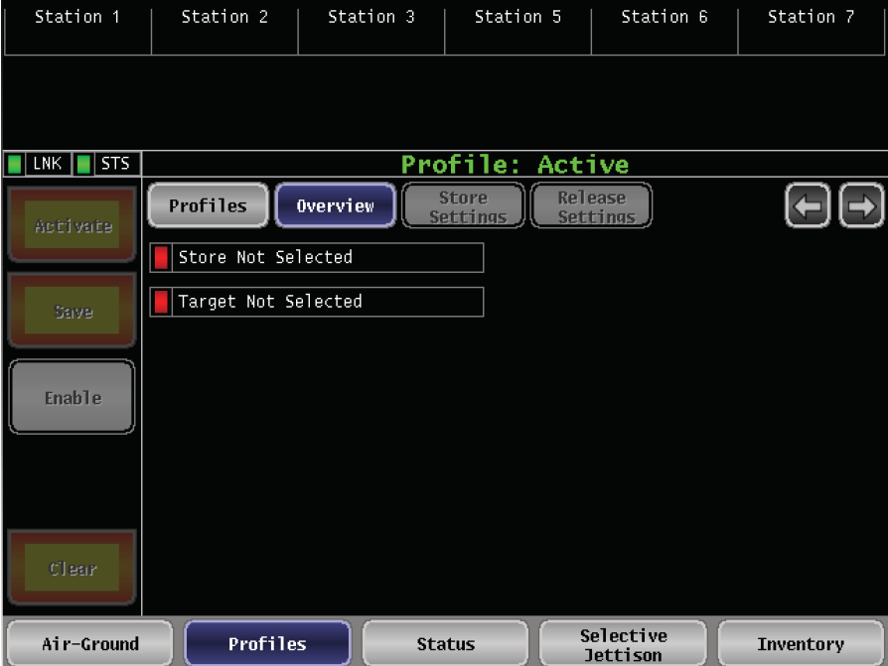
Weapons Profile Display in GSMS
The correct order for creating profiles:
Set up weapon(s) in Air-Ground per requirements
Select profiles button on bottom
Select profiles button on top left
…Continued on next page
3
1
2
Notes:
Preload/save weapon release order, intervals, and settings
Allows quick access to frequently used configurations
Cycle through profiles via HOTAS

Slide 38
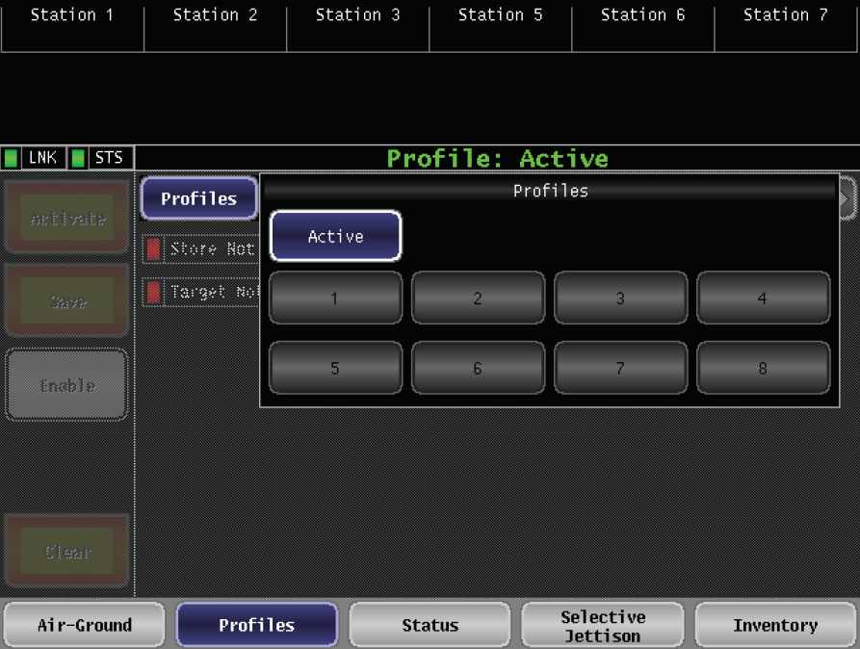
Weapon Profiles
4. Select the number you want this profile to be
5. Select Save
6. Repeat for next profile.
Weapon Profiles
Up to 8 Profiles can be loaded
Used for quick SCL changes due to dynamic targets
Aim to align with TF standard game plans
Depends on current/daily weapon loads
Erased after every sortie
You can save over any profile, no need to disable first
5
4
Despite the gray color these are selectable
Notes:
Profiles are active, but all profiles are empty

Slide 39
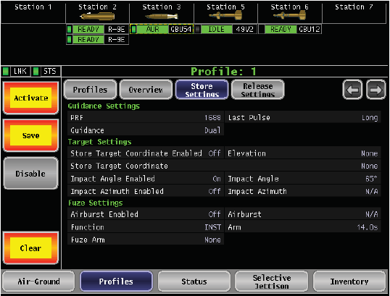
Weapon Profile Store Settings
Profile Selection
Overview
Store Settings
Release Settings
Can activate or disable Profile from this page, but not required

Slide 40
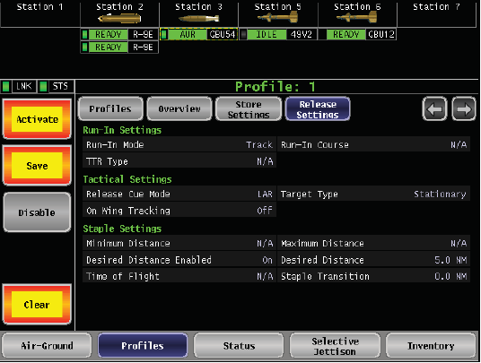
Weapons Profile Release Settings

Slide 41
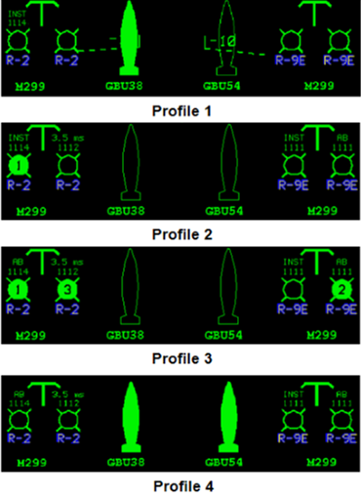
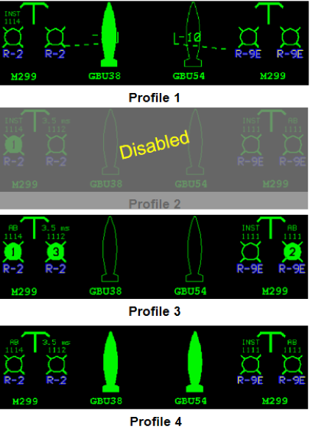
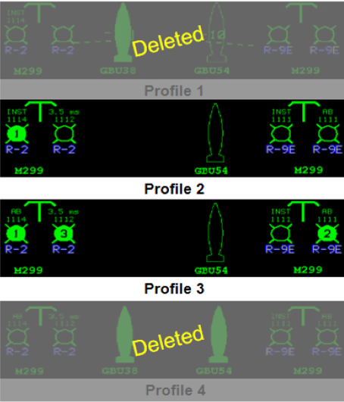
Weapon Profile
Profile Manually Disabled
Weapon released

Slide 42
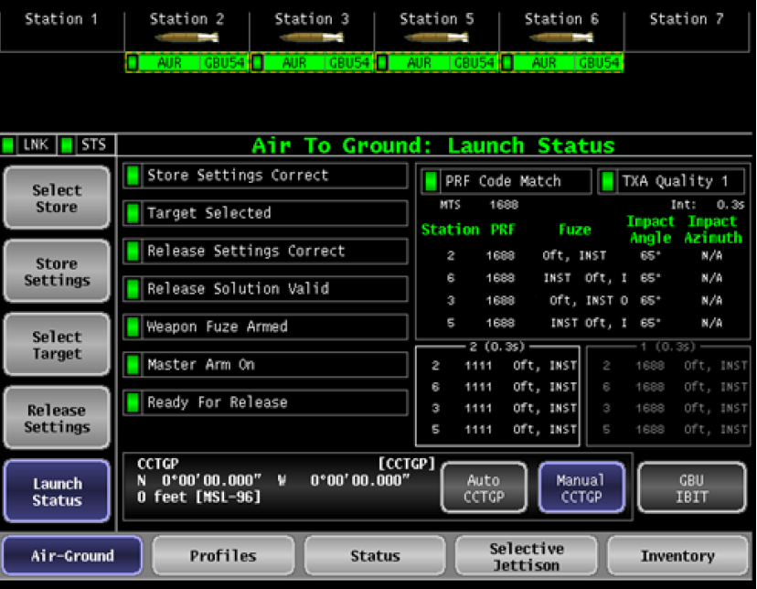
Launch Status Page Profiles
What you have currently selected to employ is in the standard “Status Section”
The Profile that is ready to be activated is outlined below the current selection
The Profile that will cycle next is greyed out
Any profile can be adjusted from the A/G pages without having to be saved, if you don’t save it though it will not keep those changes if you switch to another profile

Slide 43
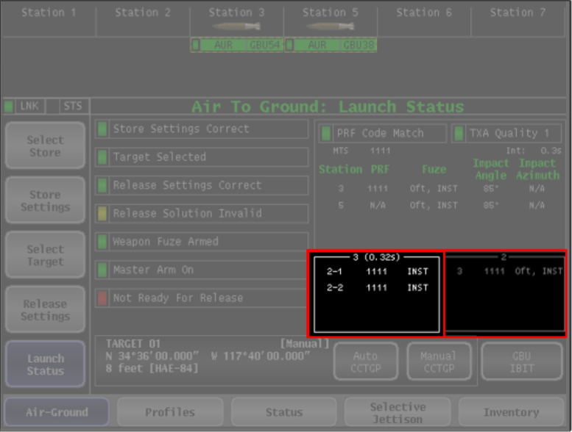
Launch Status – Weapon Profiles
Profile Preview Group Boxes
Two displayed at a time
Left Box is the READY to activate (don’t bite off on this as your current selection)
Right Box is the NEXT to activate
Ripple Intervals displayed as well
Once a profile is selected you will not see that profile # in the Status section

Slide 44
Launch Status Page Changes
Updates
PRF Code and Airburst Option
GBU IBIT button displayed
Weapon Profiles display
PRF N/A for GBU-38
TXA Quality moved
Staple Transition no longer shown

Slide 45
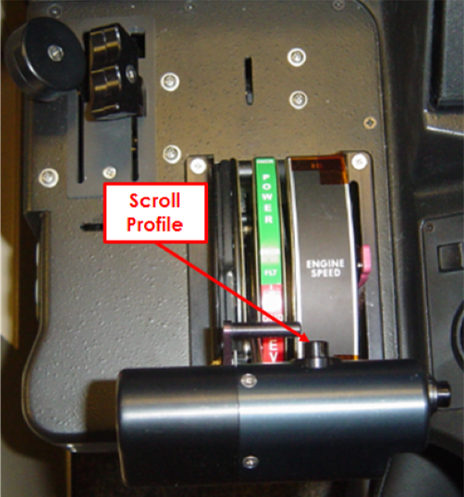
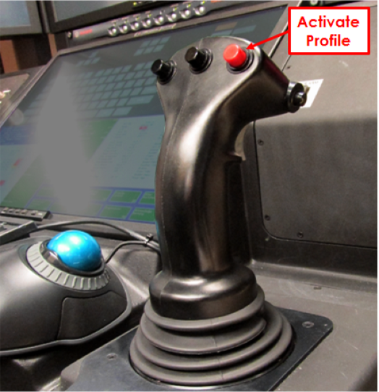
Weapon Profile using HOTAS
Just like Rifle, you need to press and hold the red button for a second, the status area should black out for a sec and then come back with the selected profile ie: don’t quick pickle

Slide 46
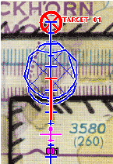
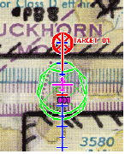

Similar HUD View as GBU-38 for Static
Range LAR triangle
Opt Dot
Zone LAR brackets
Horizontal LAR staple
Weapon Icons
Range LAR triangle
Notes:
Similar to GBU-38 Visual Cues

Slide 47
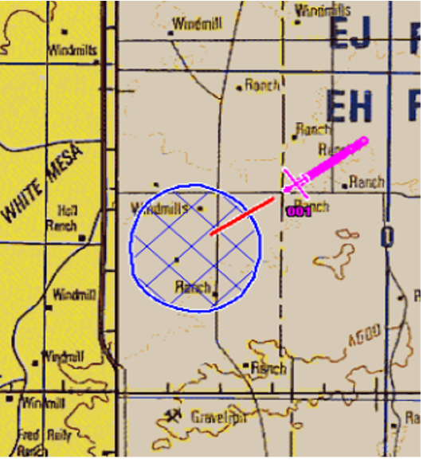
JDAM LAR (Moving Targets)
CEP 50 LAR
Similar to HF WEZ
LAR will not go away with bank, but JDAM is a level release weapon only (considered +/-15deg according to Boeing)
LAR is limited to +/-5deg of Pitch, 35,000Ft HAE and moving target of 75mph (LAR will disappear if any of those conditions met)
2 Displays for LAR
Normal looking LAR that “flies” out in front of A/C
Staple LAR on the HUD w/run-in line (use CP on staple for timing cues) on the tracker
Notes:
Laser Code hard coded into munition. Default value will be 1688 in the GSMS.
If Target Type is Stationary - Impact angle from 30 to 90 degrees
If Target Type is Moving - Impact angle from 65-90 degrees
Functional Delays can be added on top of APS setting for airburst for Fine-Tuning of Airburst Height
1 ms delay = 1 ft of weapon travel
5 ms and 15 ms delays are only viable choices

Slide 48
TACTICS

Slide 49
Direct-To GBU TTP
The new Direct-To (Fly Here) function provides a stable, wind adjusted course for GBU run-ins
3 Limitations
Takes 2 actions to disable (HDD or Tracker) HDD faster
Won’t specifically center FPM/BSL
If FPM/BSL not within 3-1 Shot Kill parameters: Turn Off, Center FPM/BSL, reengage
First time Direct-To is used it can take up to 10sec for initiation
Transitioning from one D-To to another is much faster, so start one before
For Timing attacks lead turn by 5 sec
For all attacks, turn off @ 15 sec TTR to allow full control for post release maneuver (anti-nadir turn or level straight-thru)

Slide 50
Composite LAR
2407 capable of dropping GBU-38 and GBU-54 simultaneously
SMS will only show steering target on the Tracker
Can use TRBs, OP Msn points, Collection List, or Manual SMS targets to display secondary target
TW/HW attacks recommended (impacts will a few secs apart)
Splitting the targets or aligning targets with run-in course makes very little difference on the LAR. Prioritize winds for run in.
Higher and Faster are best ways to increase LAR, in that order.
Capable of offset targets up to 1500m

Slide 51
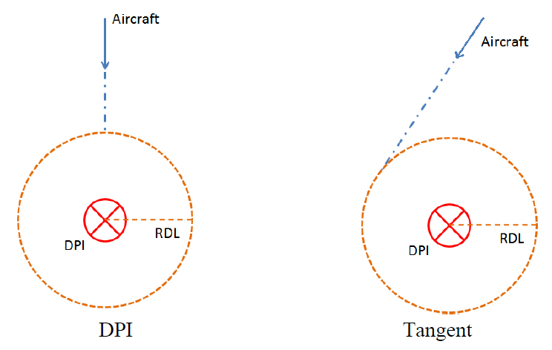
General TOI Updates
TOI now selectable between DPI and Tangential
DPI will give you TOI for the actual target
Tangential is the old way that timed to a point 90 off from the target
JDAM TOI limited to Manual mode only
Requires use of GBIT to develop manual LAR and TOF
GBU-12 TOI works for both CCRP and Manual
In CCRP it is using the Ballistic Release Point as the RDL
HF TOI can be used in WEZ or Manual Modes
In WEZ mode if you set RDL behind you (15km) your TOI becomes instantaneous (like in RMIT), but requires you be within a valid WEZ to display
If you set an RDL (5km) you don’t need to be in a WEZ for it to show, but you have to be outside your RDL for it to be accurate, TOI will be based on release at RDL
TOI is wind corrected using your Ground Speed, not exact winds so it lags.
Notes: HF SMS TOI matches RMIT TOI +/-2 secs
30º bank can make up about 3 secs and 35º bank about 6 secs from 180 out if you turn late

Slide 52
TOI Limitations and Info
TOI is wind adjusted, but it has trouble accounting for directional changes with strong winds (greater than 30kts)
Executing timing from greater than 150 Az will usually make you late by about 15 sec unless you make bank corrections early
If you see TOI changing, make major bank correction early and then correct back to Std Rate turn as needed
Provide yourself with enough time on final to allow for timing corrections
Make sure Roll Shaping is on to make an aggressive turn-in
Desired Distance in Release Settings Page must be on for TOI to display

Slide 53
GBU TOI TTPs
Single GBU
Hold 4-6nm, Figure 8, Turns into the Tgt, 175TAS (to allow timing corrections)
Technique 1:
2 sec prior to TOI execute STD Rate turn in closest direction to Tgt
Adjust bank angle to hold TOI constant, center BSL with FPM
Make standard timing corrections on final to make TOI match TOT
Technique 2:
During holding use Direct-To to on last leg of the hold to keep you 90 AZ
Ensure STD Rate Mode is engaged in HDD
15 sec prior to TOI select fly here over the target
Make standard timing corrections on final to make TOI match TOT
15 sec prior to TTR turn off using HDD to execute post release maneuver
*Assumptions: Immediate turn initiation, light winds.

Slide 54
HF TOI TTPs
Hellfire with an RDL (Best)
Hold 2-4km out from selected RDL ie:5km RDL, Hold 7-9km
Turns into target, A/S as required
2 Sec prior to TOI begin STD Rate turn shortest direction into target
Adjust bank to hold TOI constant
Hellfire with no RDL (Adequate)
Set RDL at 15km (this keeps your TOI instantaneous from current position)
1: If possible arc target, and turn in 2 sec prior to TOI, Roll out on AZ (as required) and/or rifle at TOI
2: Stay in sector/restriction and turn in 2 sec prior to TOI, rifle at TOI
Limitation: when turned outbound your WEZ may disappear and then you lose your TOI until you enter the WEZ again.
*Assumptions: Immediate turn initiation, light winds.

Slide 55
Trouble Shooting
If you have a laser weapon selected and the MTS is not powered on you will get a yellow “Ready for Release” and a CCTGP not ready caution
If the MTS data is not valid you will get a yellow “Ready for Release” and MTS Target Data Invalid caution
On Wing Tracking details can be found on the Detailed Status page under station status
Options are: Not commanded, Acquiring, Marginal or Good

Slide 56
CWL and WDF
2407 uses .dll files
GBU loading is very quick and easy
HF loading is the same as before
CWL server icon looks different than before (white background with a HF above a GBU vs the green background WDF loader from before)
When opening CWL the GUI is slightly different
Ensure all servers are connected if not getting a LAR
There is a WDF button on the main CWL GUI that opens the WDF loader that has the same interface as before

Slide 57
DLL Loading Procedures
Open CD
Open Software Configurations
Open 32-bit .NET 3.5
Open Installers
Run Weapon Plug-In Interfaces
Run JDAM Installer (exe or msi)
Run LJDAM Installer (exe or msi)
Open CWL
Open WDF Loader
Activate each GBU with big green button
If weapons don’t show up, it could be that the other MFWs have CWLServers/CWLTrays running and causing a conflict

Slide 58
Lessons Learned
New Nadir Avoid tool, if activated, will cause the MTS to swivel around during a level straight-thru if depression gets above 88deg
TOF only shows with a JDAM when in the LAR
Need to toggle between Auto Update and Manual Update in order for the SMS to pull MTS info. If you Manual twice, it will input DTED data.
Laser BIT failures over 4 sec will lock out Laser Mode for the GBU-54, must switch to GPS only mode to release if that’s the case.
Like previous software: must power off wpns and deselect during handover and make sure Auto CCTGP is deselected before inventorying weapons or you get an SCC Software Fault
3sec TOF not enough time to shift a GBU-54 (real world test)

Slide 59
CLAW .449 (yes we are still using this)
Simplified HMI now has Ad-Hoc and Pre-Planned Brickmap options
Both Ad-Hoc has a preview mode to show how much will be captured. Once activated continues until stopped
Pre-Planned starts with a center point and then expands out in both directions, plan accordingly.
Super Ping
Provides user with detailed steps to fix warnings and cautions
Maritime Wide Area Search (MWAS)
Now available with a cheat code, contact Chad “Lyft” Waldorf at the 556TES
Shows up next to MTI button on Legacy HMI

Slide 60
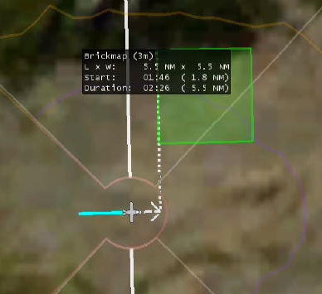
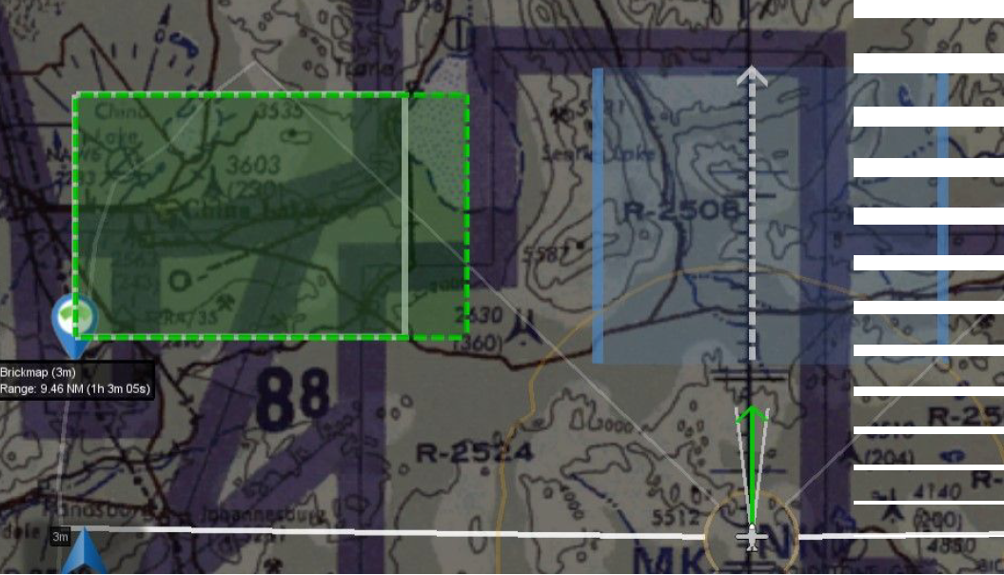
Brickmap Images
Ad-Hoc Brickmap
Defined Brickmap

Slide 61
System Function Timeline

Slide 62
References
GBU-54 Initial Fielding, Aircrew Training (MCE), GA-ASI Jan 18 2018
27th XPU Cannon AFB, GBU-54 Integration PowerPoint, Jan 11 2018
JDAM Weapon Delivery Source Data for 1-1M-34, Nov 5 2015
Maintenance Training (LRE), GA-ASI, Dec 13 2017
LJDAM Information, Boeing, Nov 27 2017

Slide 63
QUESTIONS?

Slide 64
LJDAM Guidance (Boeing)
Uses Baseline Guidance to Initially Guide to a “Phantom Aimpoint” 4.5km Slant range from tgt along the planned impact angle
Optimizes target location in the sensor FOV
Optimizes maneuverability once laser measurements are acquired
Arrives at P.A. with selected impact angle, disregards IA once tracking laser
Precision Target Tracker (PTT) Processes Laser Sensor Elevation and Azimuth Measurements to Maintain Precise Target Position and Velocity (if applicable) Estimates
Continuously provides guidance with most recent estimate of target intercept position, including a correction for target velocity
Contains an acceleration detection algorithm for engagement of maneuvering targets
Very dependent on MTS track at release
Switches to LJDAM Terminal Guidance During Terminal Phase
LJDAM flies to the calculated estimates, not directly to the laser spot
No need for aircrew to lead target, uses proportional navigation (Pro-Nav) w/calculations
Impact Angle is not controlled in LJDAM terminal guidance against moving targets only to P.A.

Slide 65
Trajectory Comparison(Boeing) LJDAM versus JDAM

Slide 66
Warheads
MK-82
Std bomb
BLU-126 and -129
Low Collateral Types (LOCO)
BLU-111
Penetrator

Slide 67
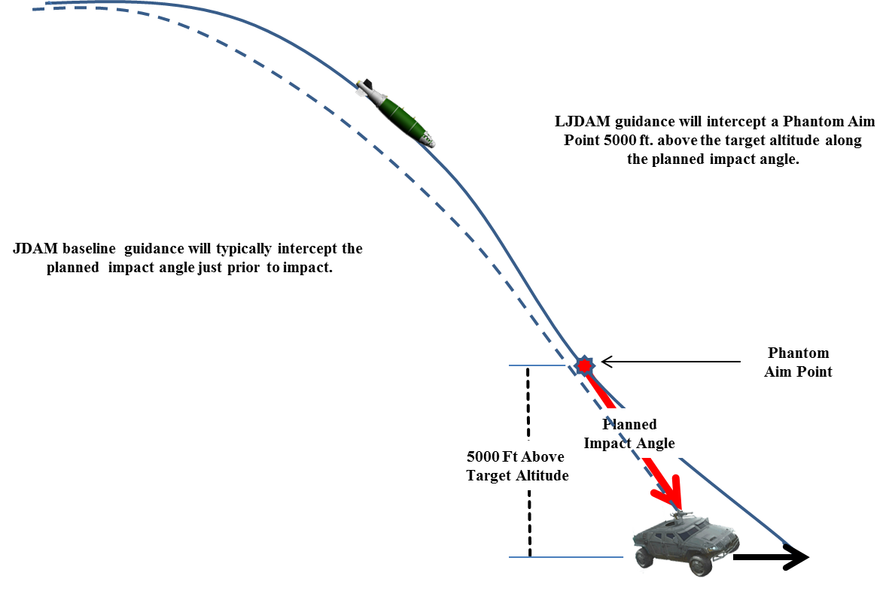
Laser Guidance – Phantom Aim Point(Boeing)
LJDAM Optimal Guidance is modified from baseline JDAM to provide a more favorable view of the target by the Laser Sensor by initially guiding to a Phantom Aim Point if moving target selected.
38vs54
LJDAM guidance will initially intercept a Phantom Aim Point 4500 meters slant range from the target at planned IA, then flies to target regardless of IA
JDAM baseline guidance will fly an optimal trajectory that will attempt to be along the planned impact angle at the P.A.

Slide 68
Laser Updates for Terminal Guidance
4.5km to target
Arrives here at desired IA
PAP of moving target

Slide 69
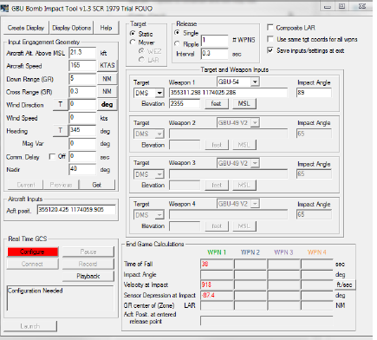
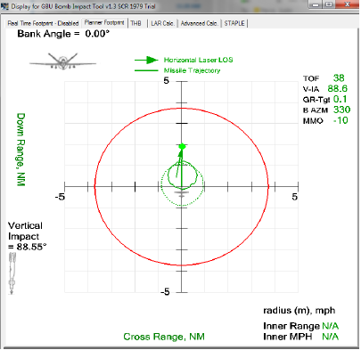
GBIT Displays

